Slide 1
2011-2014 California payroll analysis
CSC550 CAPSTONE JINZHONG.ZHANG, XU.LIAN
03/19/2016

Slide 2
Agenda
Project Description
Data Description
Views Over the Years
Major Findings
Technical Approach
Summary of Work Experience

Slide 3
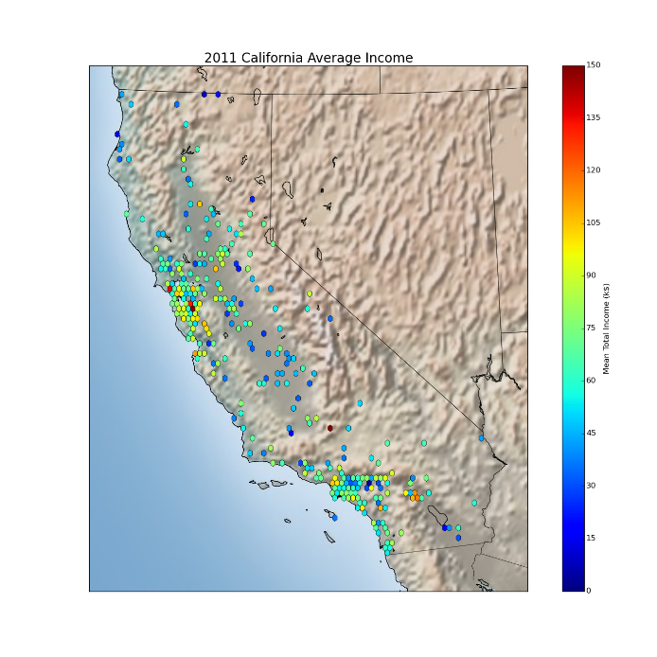
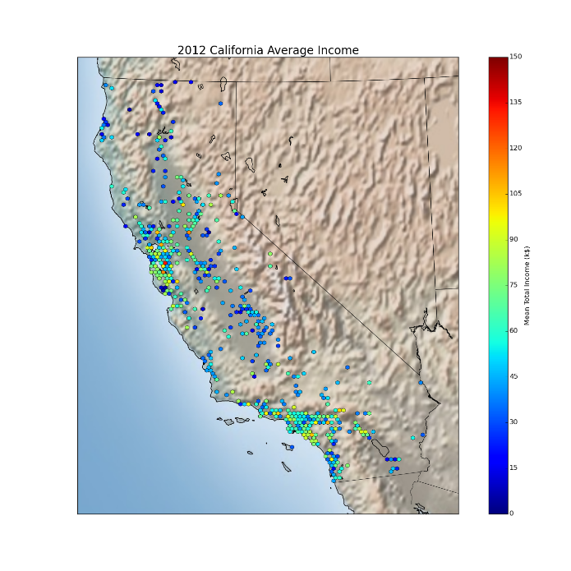


PROJECT DESCRIPTION
Based on the released California payroll data between 2011 to 2014, this project mainly focus on analyzing the trends of total income and the income geographic distribution

Slide 4
Data description
Data Source: California payroll data set from 2011 to 2014
Data Size and effective records
total: 960.6MB
2011: ~1.2 million payroll records 2012: ~2.0 million payroll records 2013: ~2.3 million payroll records 2014: ~2.4 million payroll records
Effective locations analyzed: over 1200 cities
Parallelized threads: 8-34 threads, according to data size
Data Format ( 150MB to 250MB csv file for each year): “Employee Name”, “Job Title”, “Base Pay”, “Overtime Pay”, “Other Pay”, “Benefits”, “Total Pay”, “Total Pay & Benefits”, “Year”, “Notes”, “Agency (City name)”

Slide 5
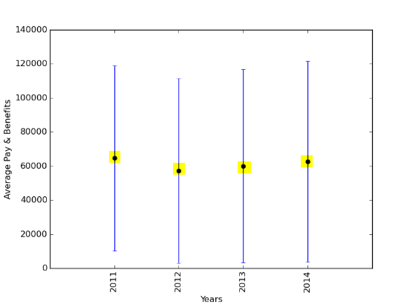
Average payroll compare
Views Over the Years

Slide 6
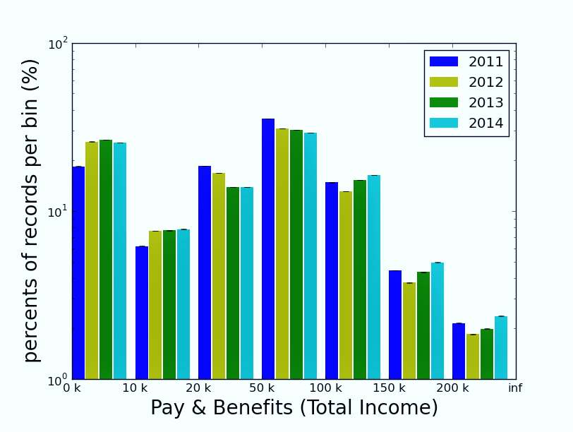
Total income comparison among years
Views Over the Years
Total Income trends among years
Difference between average total income and medium total income

Slide 7
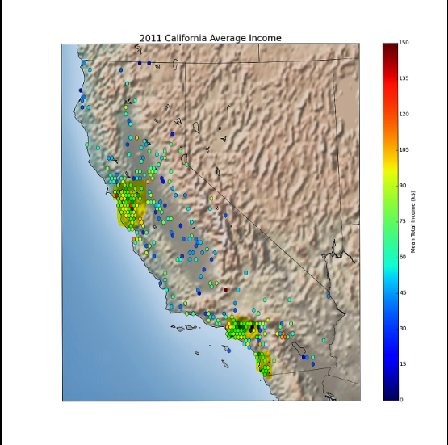
2011 California average income
Major Findings
San Francisco bay area
Los Angeles
San Diego

Slide 8

2012 California average income
Major Findings
San Francisco bay area
Los Angeles
San Diego

Slide 9
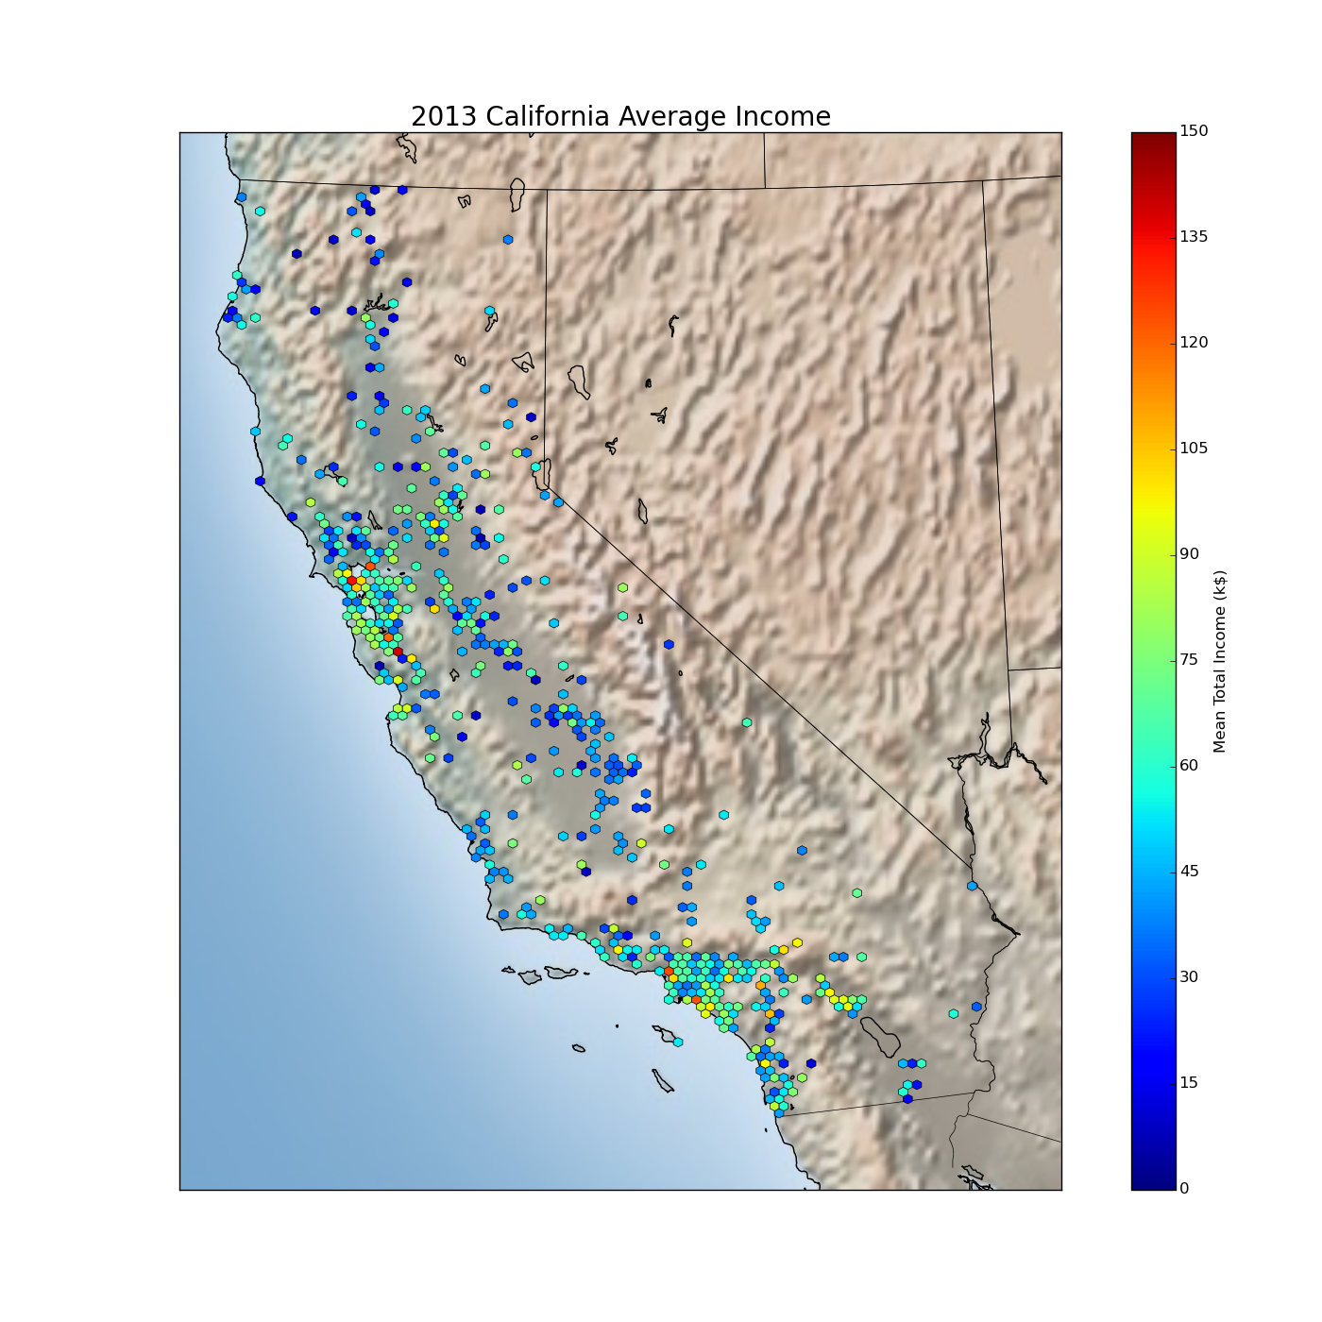
2013 California average income
Major Findings
San Francisco bay area
Los Angeles
San Diego

Slide 10

2014 California average income
Major Findings
San Francisco bay area
Los Angeles
San Diego

Slide 11
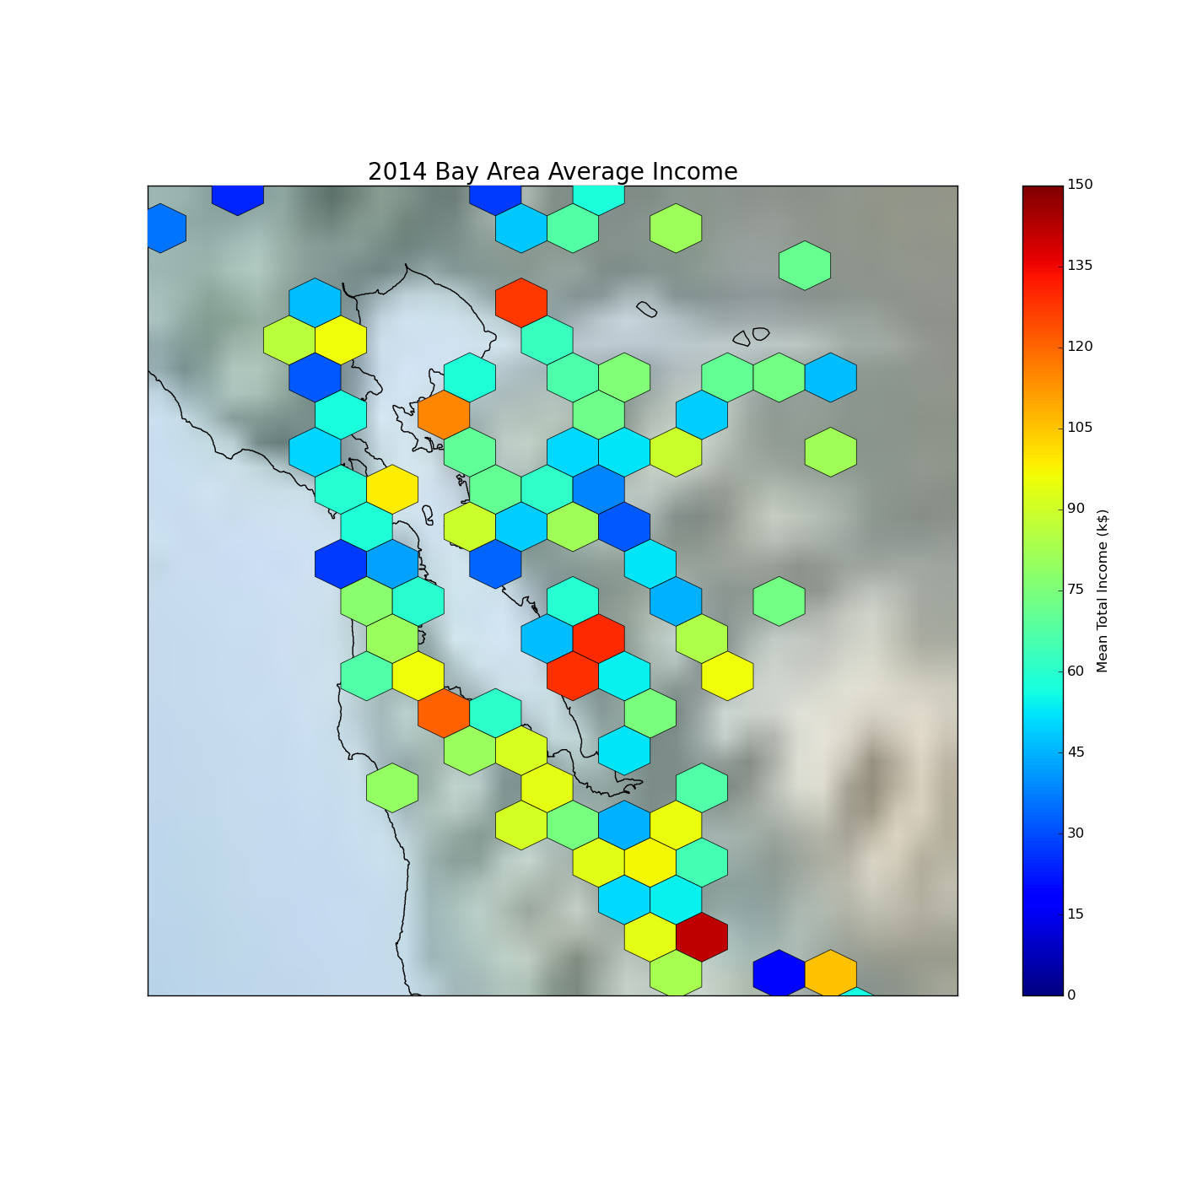
2014 San Francisco bay area average income
Major Findings
Relative high income cities:
Oakland
Fremont
Newark
San Jose

Slide 12

Performance
Make histogram & scatter plot
Hexbin Plot on MAP
All ~8 million records:
sec
Compare to SQL:
>1 day?
For one year ~2 million records:
sec
Compare to SQL:
? ? ?

Slide 13
Technical approach
System requirements and software dependence
Installation
Implementations

Slide 14
System requirements and software dependence
Spark-1.6.0
Python >= 2.7
(optional, for single machine not necessary) Hadoop HDFS 2.0
Python packages:
matplotlib (1.4.2) → python plot making library
basemap (1.0.7) → make plot on real map
geopy (1.11.0) → convert addresses or county names to (latitude, longitude)
http://download.osgeo.org/geos/geos-3.5.0.tar.bz2 → geopy dependence
Cloudera VM is not supported. This is because the Hue job monitor of Cloudera uses Python 2.6 . geo & map is not supported by Python 2.6. Python 2.6 is no longer supported by the Python team.

Slide 15
Installation
Check versions: python --version pip list | grep ‘basemap\|matplot\|geopy’
Installation:
sudo pip install geopy
sudo pip install matplotlib
sudo pip install basemap
wget http://download.osgeo.org/geos/geos-3.5.0.tar.bz2
tar -xvf geos-3.5.0.tar.bz2
cd geos-3.5.0
./configure
make
sudo make install

Slide 16
Implementations

Slide 18
Summary of Work Experience parsing
some cells in csv include “,” inside “” csv.reader(StringIO(line),strict=True, skipinitialspace = True, quoting = csv.QUOTE_ALL, quotechar = '"', delimiter = ',', lineterminator = '\n')
csvreader cannot handle the cases that “\n” is inside the cell, because spark will split it into two lines Use a buffer to let spark remember the previous record. However, this fix is deprecated, because in parallelized threads, the content in the buffer may belong to another thread. It is better to throw bad data away.
none utf-8 code inside the original data file. The python will raise error. Fix: line=line.encode('utf-8','ignore')
Experience: found a good regexp to recognize all kinds of numbers (float,int, scientific) from online ‘^[-+]?[0-9]*\.?[0-9]+(?:[eE][-+]?[0-9]+)?$

Slide 19
Summary of Work Experience
Spark filter takes a long to run. Improvement: play with keys but not filters to reuse data. E.g. groupByKey → map(histogram_maker)→collect() the results
For online services. Now most of them do not like distributed computing requests It is slow for large data. When spark uses 20-30 threads, the request are too many so that the remote server will block my IP for a certain amount of time.
Fix: use a local cache, a lookup table to same the relation between the city names and coordinates.
Nowadays, many servers are NOT ready for distributed computing. They are NOT able to distinguish between distributed computing requests and attacks. Their load balancers still need to be improved.
Lots of opportunities

